Slide 1

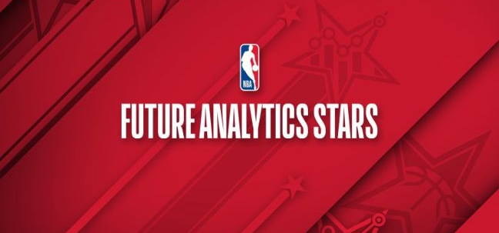

True impact shot charting
Koi Stephanos: Capstone Presentation

Slide 2
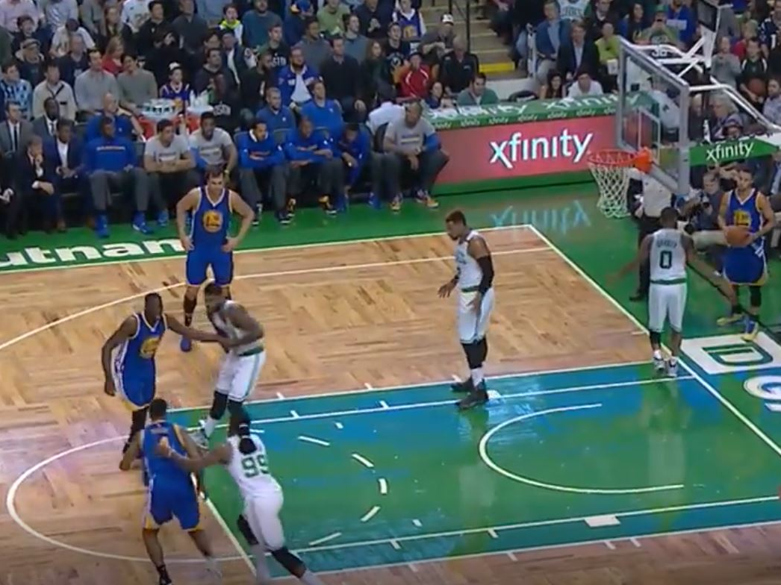
What happens when we miss?
Conventual wisdom in the NBA says if you miss a layup on one end, you will give up a basket on the other end
One of the biggest strategic challenges faced by NBA and 2K coaches alike: Crash or Get Back
Certain teams, due to a combination of principals and personnel, are better or worse t one half of this dichotomy
What if we could quantify these secondary results of shot attempts?
Notes:
The on-ball screen, commonly known by its most popular variant the Pick & Roll,
The on-ball screen provides unique benefits for analysis in that it is extremely prevalent in gameplay and both the approach and execution can be performed in myriad patterns

Slide 3
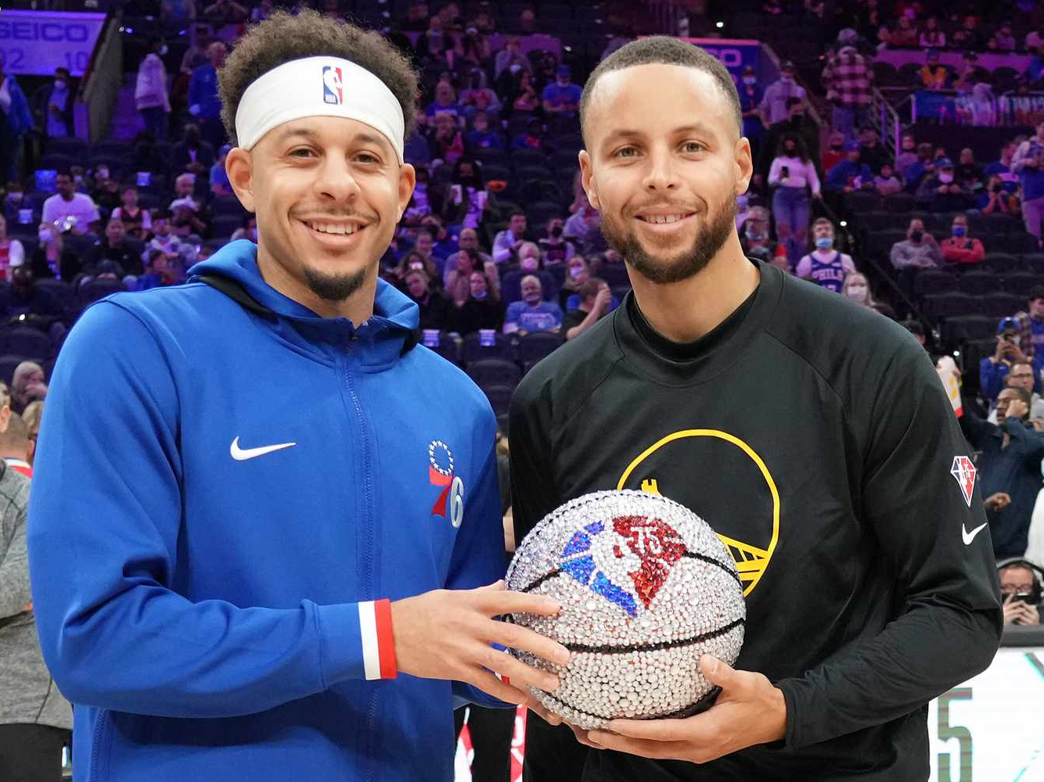
Related Works

Slide 4

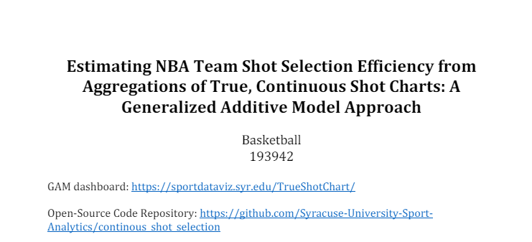
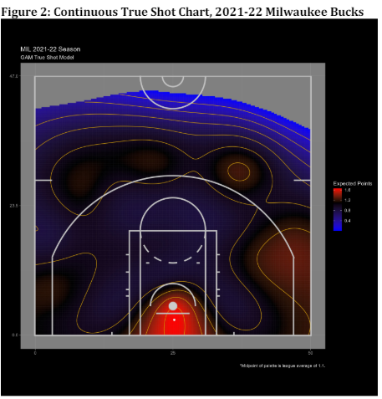
Winner of the basketball track this year at Sloan, by 2 researches our of Syracuse:
Justin Ehrlich, Shane Sanders
Integrated the potential point creation of free throws into traditional shot charting
Visualized using continuous topographical maps
Reveals the most rewarding regions for a player/team based on the full context of their scoring potential

Slide 5
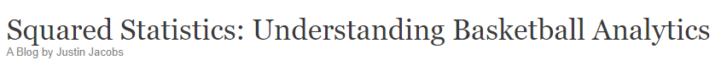
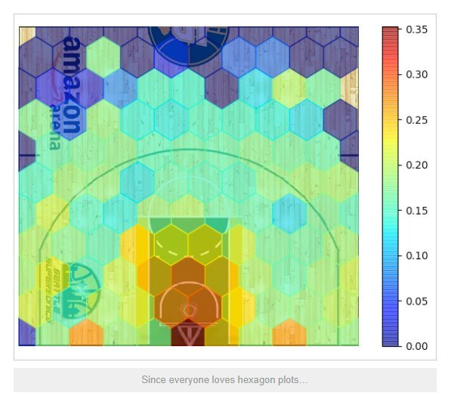
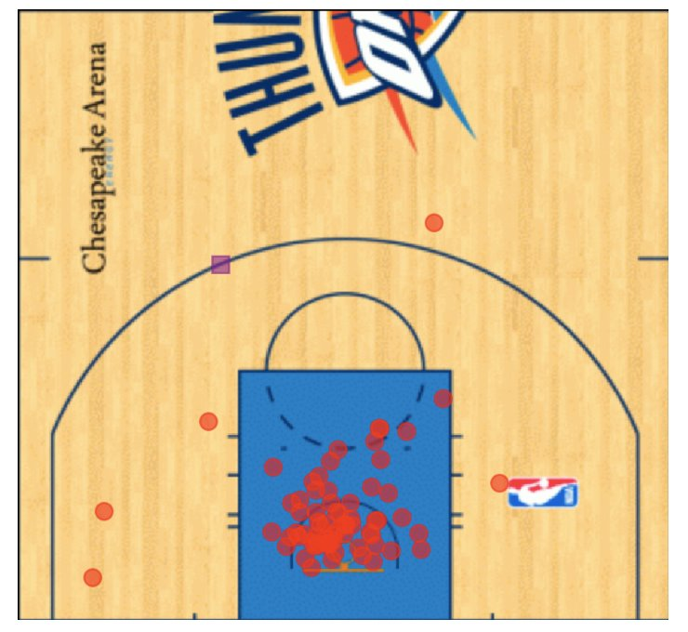
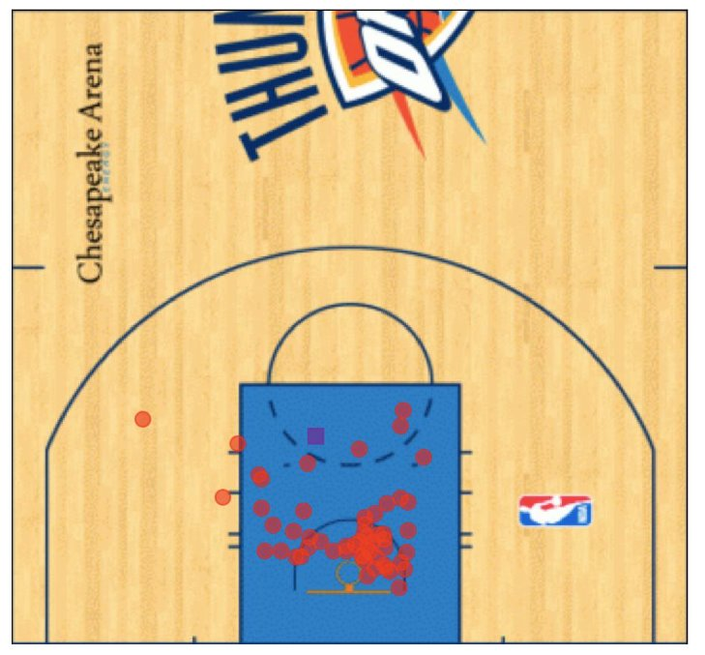
Quantifying rebound distributions
Not all shots are rebounded equally
By analyzing the rebound locations associated with various shot types/regions, we can predict where misses are likely to fall
Jacobs uses a hexagon heatmap to illustrate this distribution

Slide 6

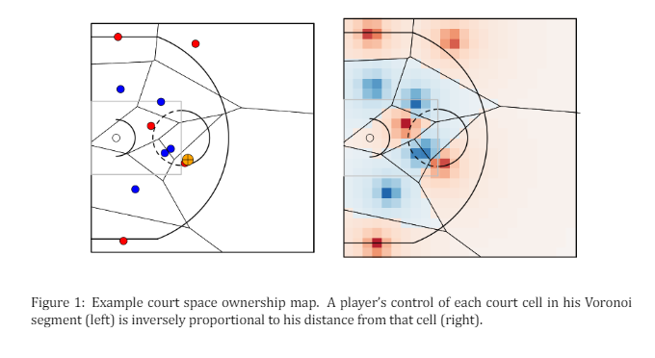
One of the early Sloan basketball publications​, helped launch the career of Kirk Goldsberry
Sought out to explain the relative value of court regions
Accomplished this via the use of Voroni space diagrams
These plots break the court into cell regions based on the geo-spatial features of the player locations at a snapshot
Used to evaluate regional preferences of teams and players on defense

Slide 7
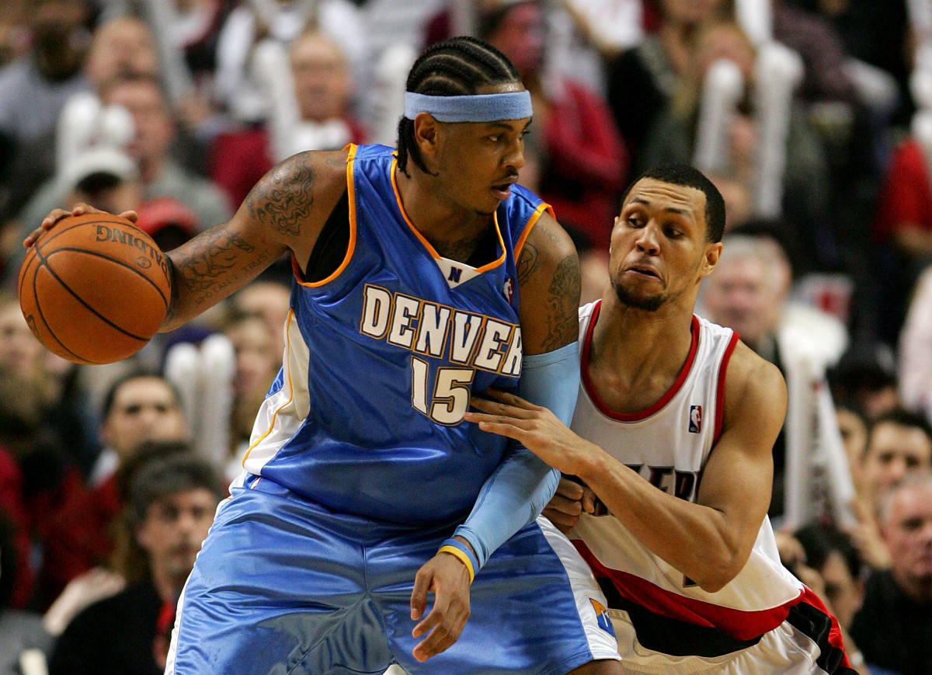
Data architecture & model design

Slide 8
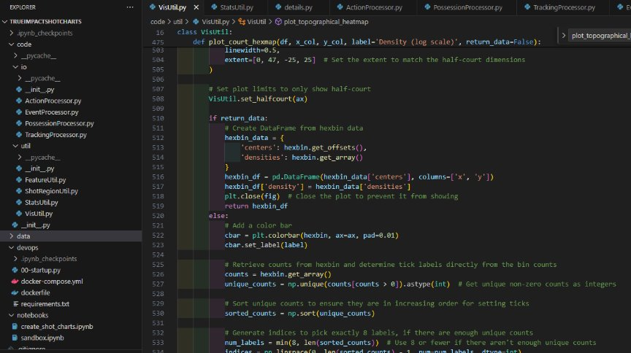
Python toolset
Collection of processor & utility classes for data processing/visualization & feature engineering/statistical modeling
Organized as a JupyterLab project
Container and dependencies managed through docker-compose
Code repository available on github
A brief aside for sample size...

Slide 9
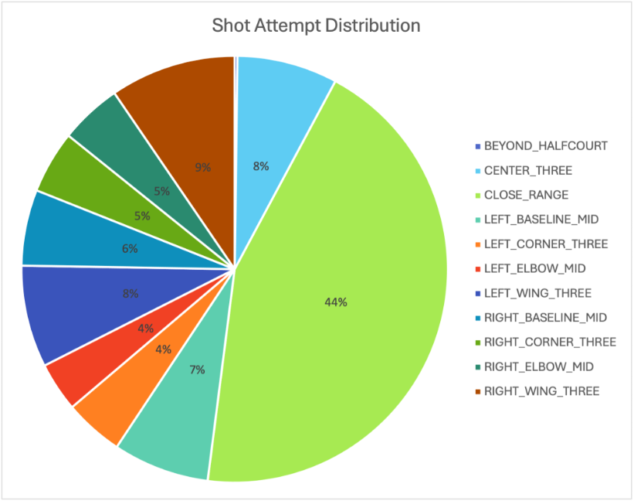
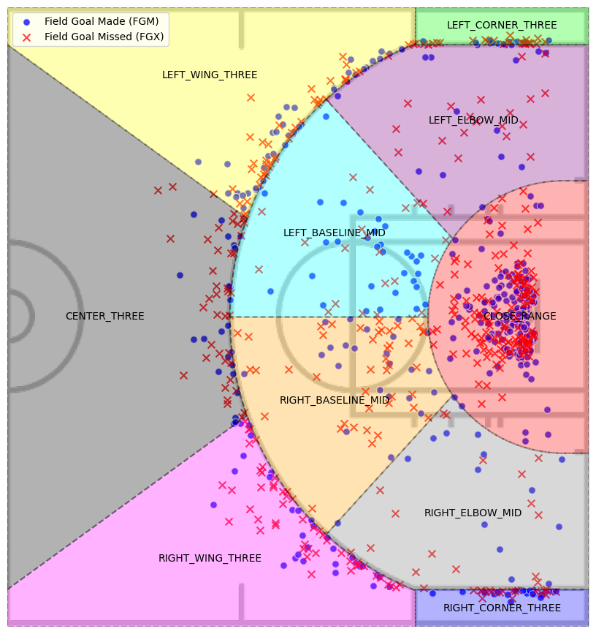
Classifying shot regions
Shot regions inspired by Kirk Goldsberry's shot charting
Modern distribution
Meaning lots of 3's and Layups
Region data can be used to qualify downstream analytics

Slide 10

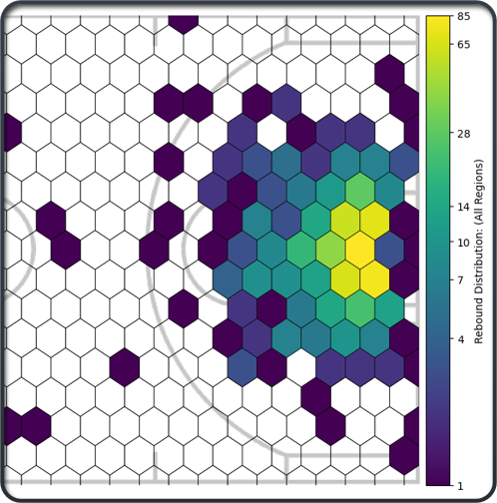
Hexbin encoding
Hexbin mapping was used to abstract away precision from the coordinate data
By assigning each coordinate to a hexagonal bin, locations for key moments can be identified by cell
These cell weights can be used later on to estimate rebounding chances per Team and Player

Slide 11
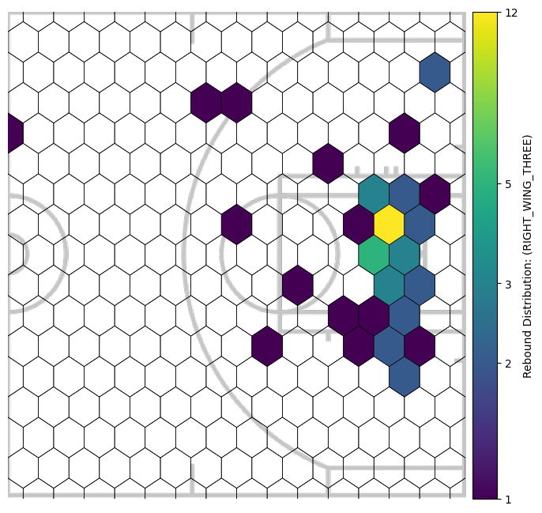
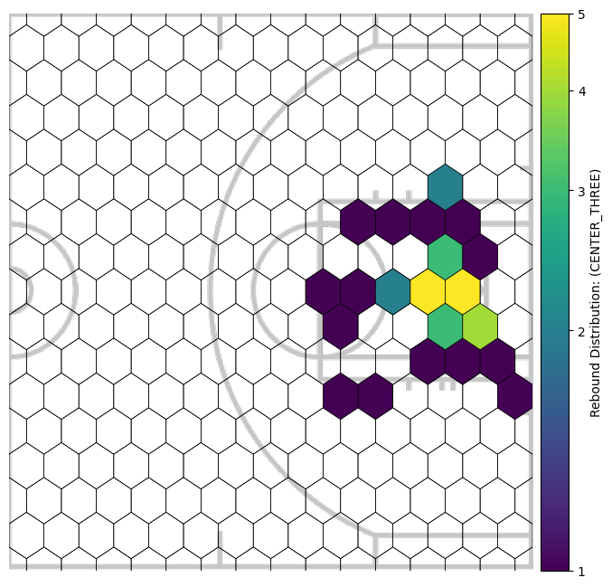
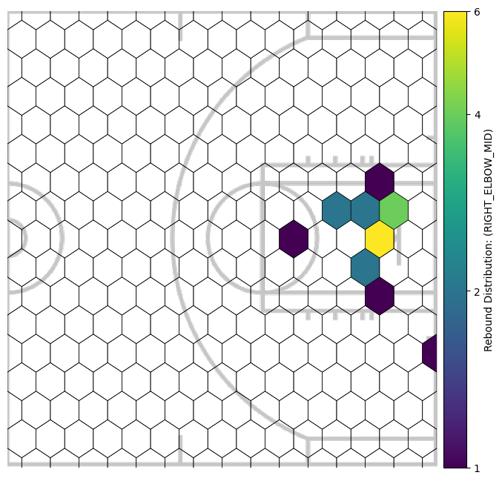
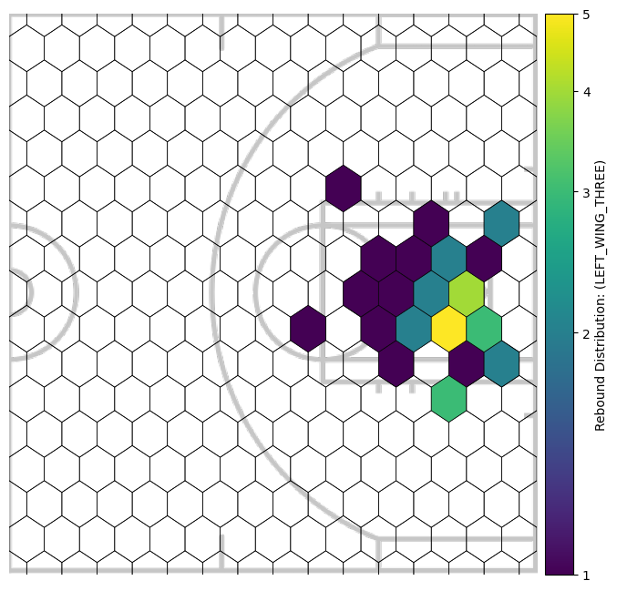
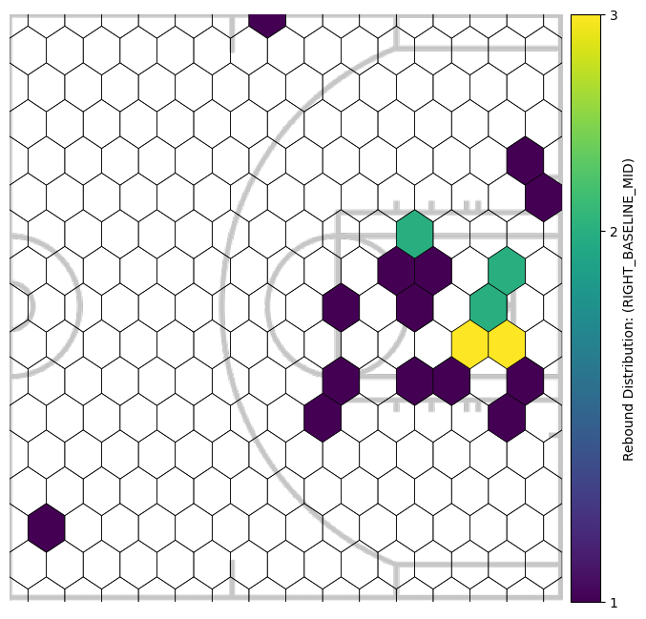
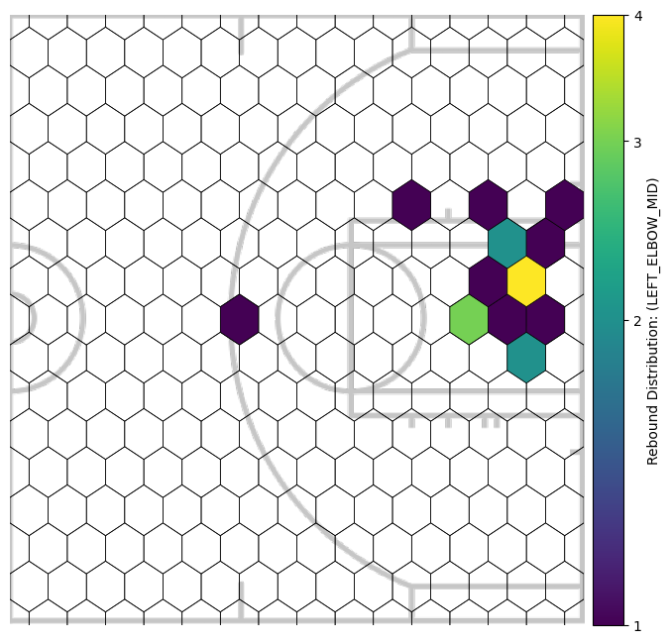
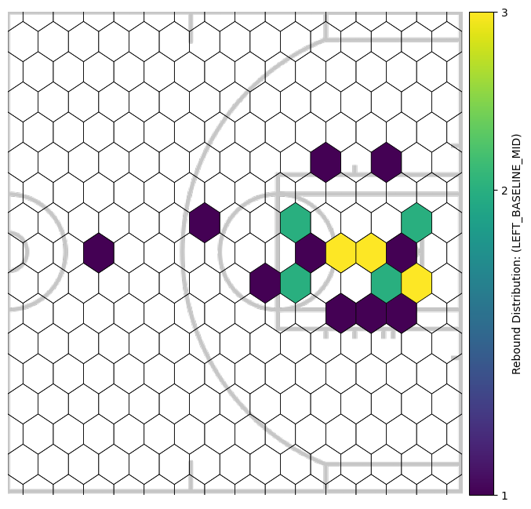
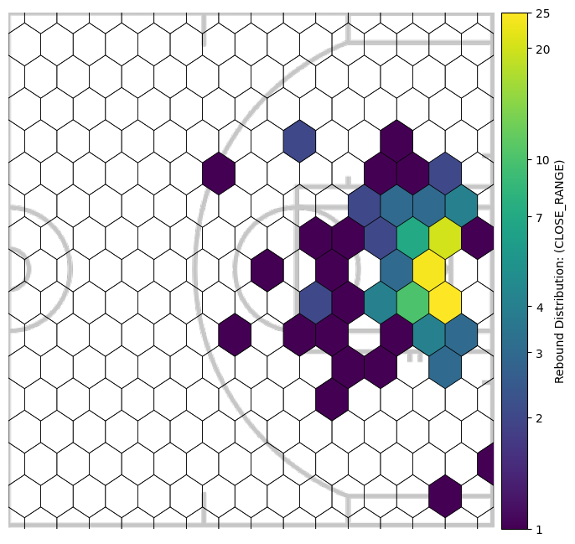
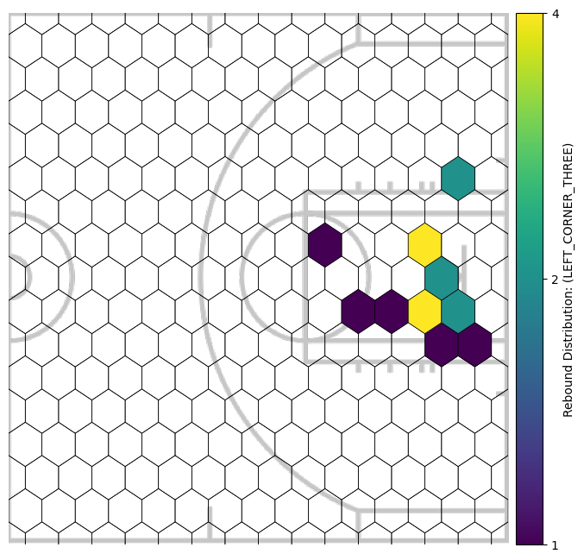
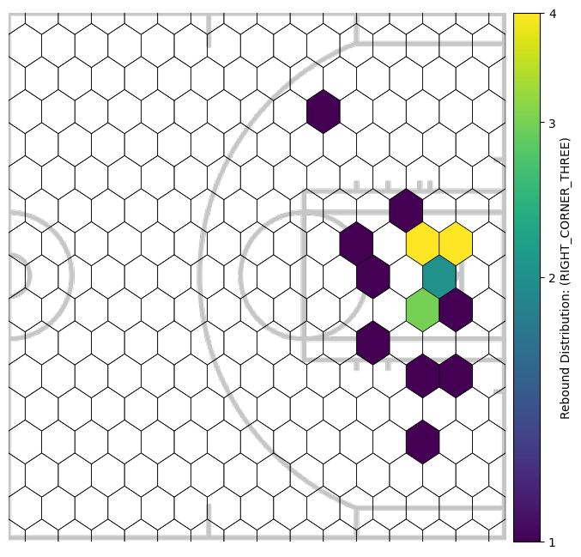
Rebound distributions by region
While all distributions show a predictable concentration in the cells nearest to the basket, with some more distinctive trends, like the propensity for corner three's to 'miss long'

Slide 12

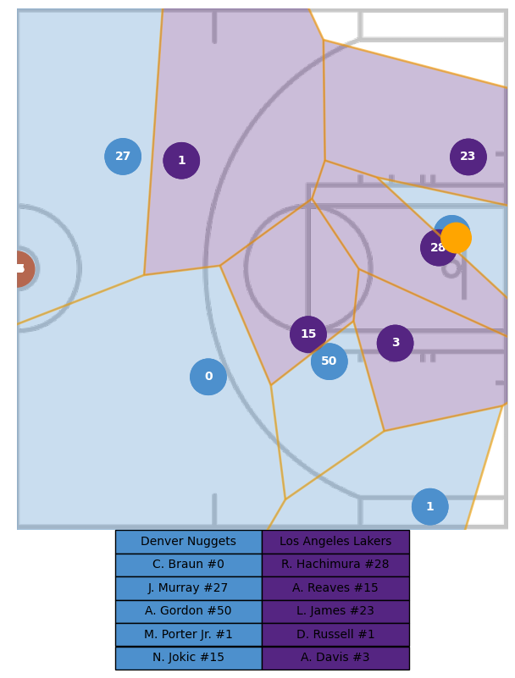
Feature engineering
Voroni diagrams are used to create player and team cells
Any hexbin in the rebound distribution contained by a cell is assigned to that player/team
The overall weights are aggregated, and a prediction is generated for Offense and Defenseive Rebound Potential

Slide 13
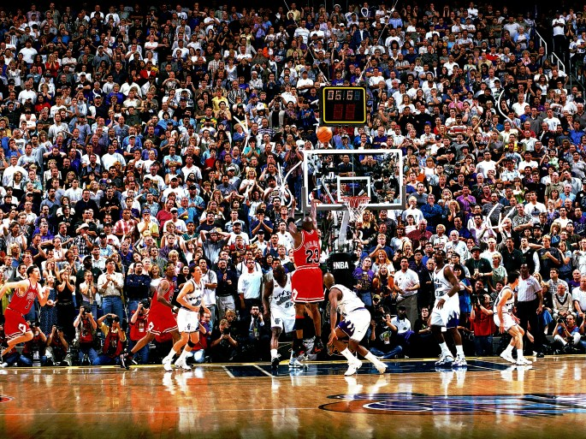
RESULTS

Slide 14

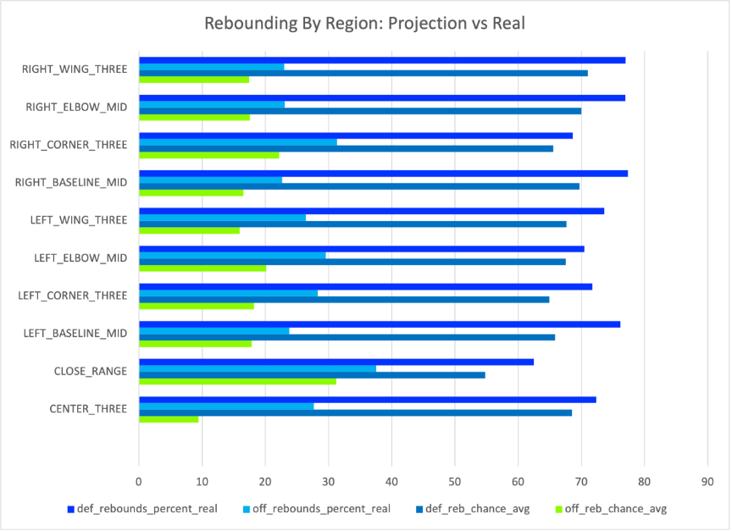
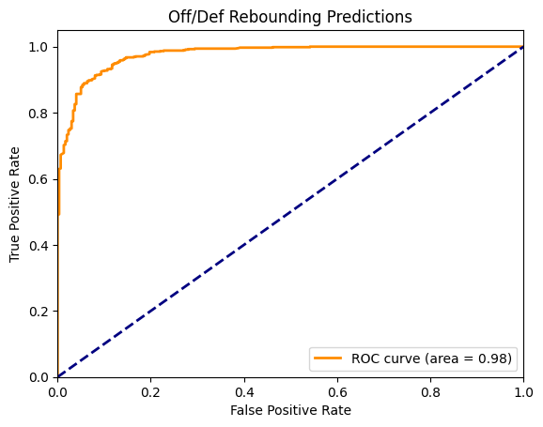
Evaluating our rebounding model
Used 2 metrics to assess model performance:
Brier score: used to evaluate probabilistic predictions
Range of 0 -> 1
0 indicates perfect accuracy
Our score: 0.0767
ROC curve: see below
Despite solid metrics, we do still see a gap between projection and reality
This could likely be overcome with additional data, or by augmenting the Voroni plots with player height & wingspan measurements

Slide 15
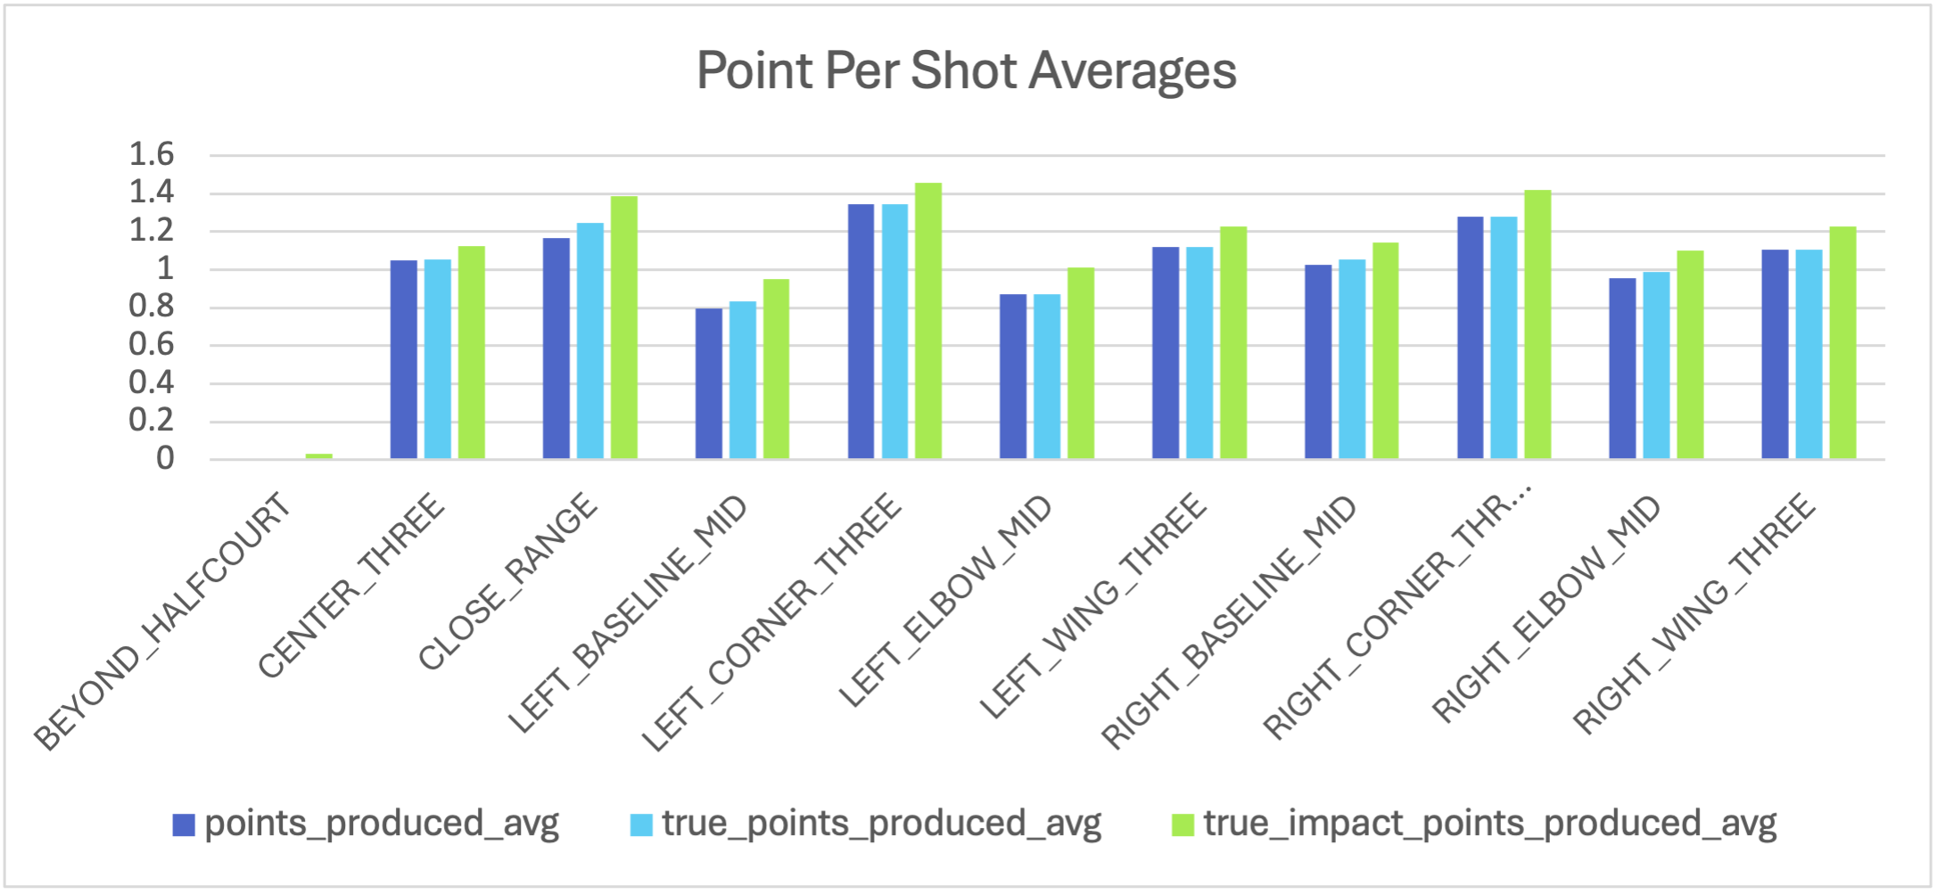
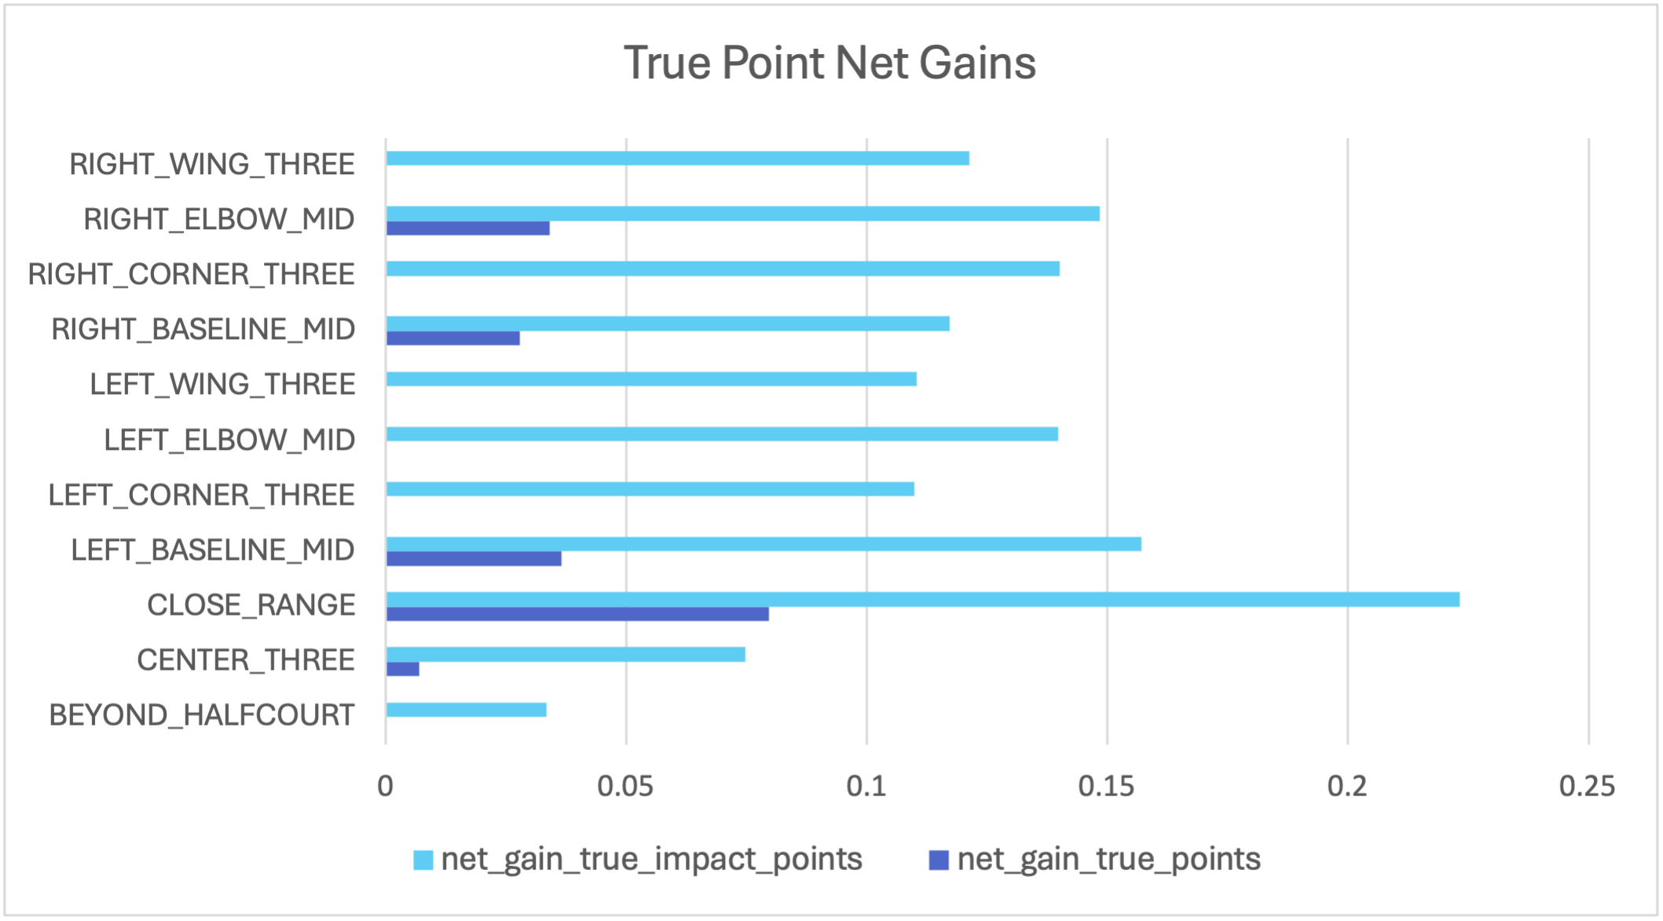
Comparing shot metrics
Both true points and true impact points extend base projection
Net impact for true points is only positive for 5 of the 11 categories
This suggests our model has potentially broader impact, affecting a greater range of potential shots
Additional foul data could affect these results

Slide 16
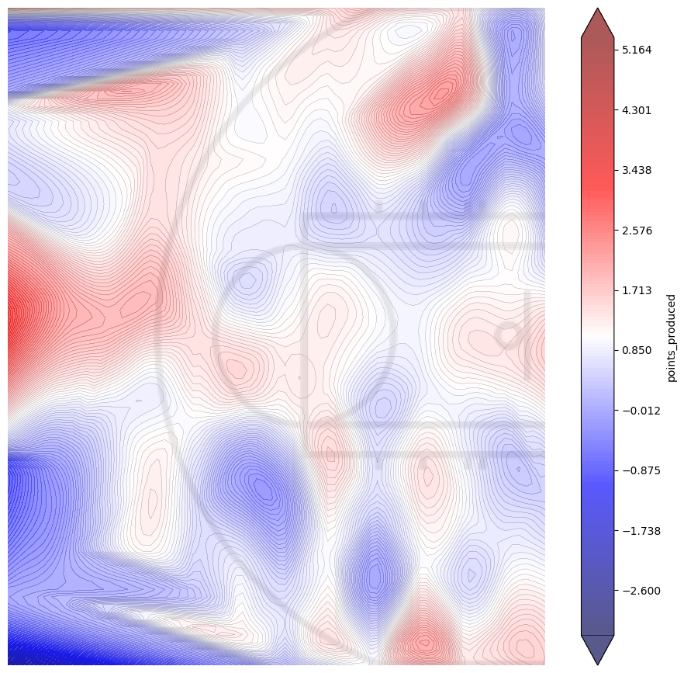
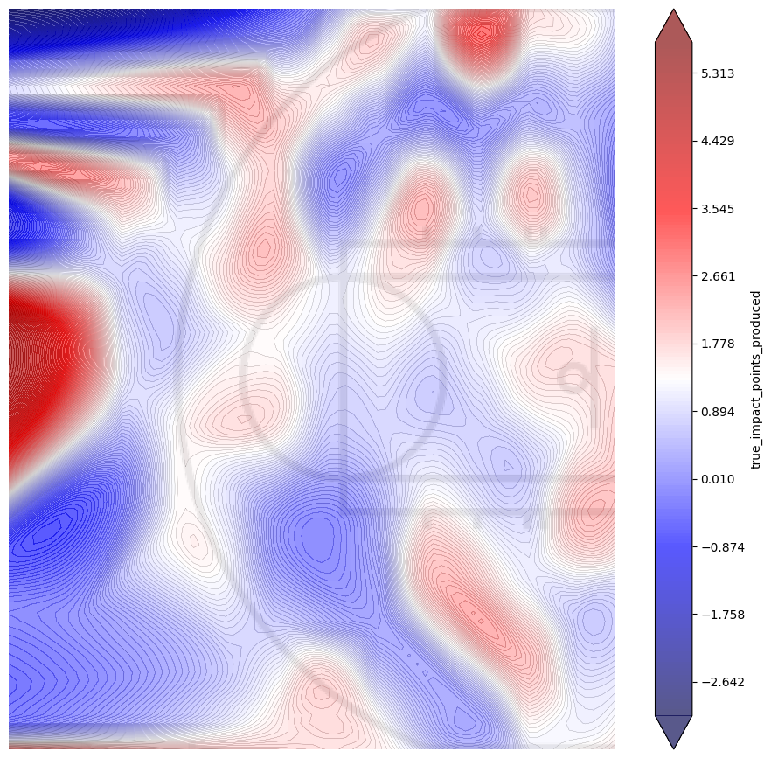
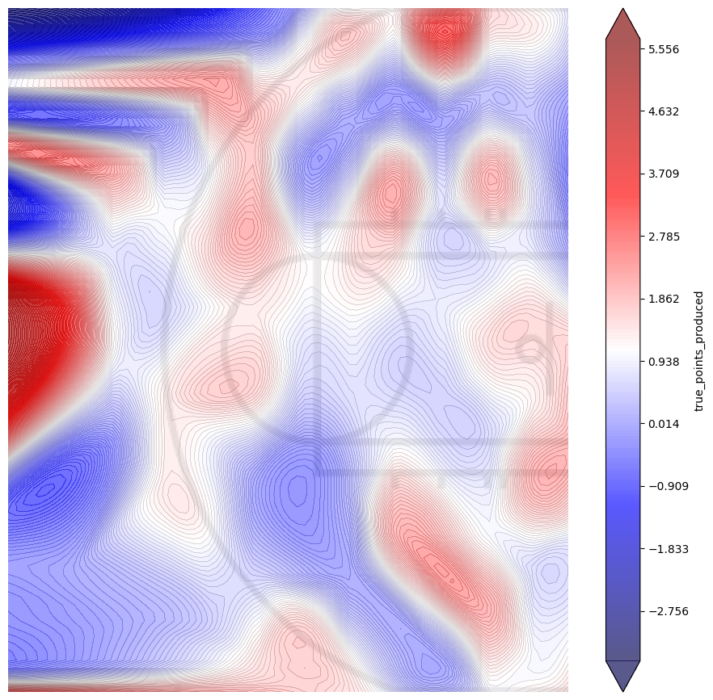
Comparing shot charts
points produced
true impact points produced
true points produced
One of the key takeaways from Ehrlich, Sanders was the overvaluation of the three-point shot, as evidenced by more prominent red regions inside the arc once accounting for FTs Our true impact points metric supports this conclusion, but does suggest less of an impact, perhaps due to the propensity of 3pt rebounds to occur further from the paint

Slide 17

Potential future Research Directions
Use region specific rebound distributions for probablisitic model
Extend true impact metric with transition defense model
Modify space diagrams to include player biometric data

Slide 18
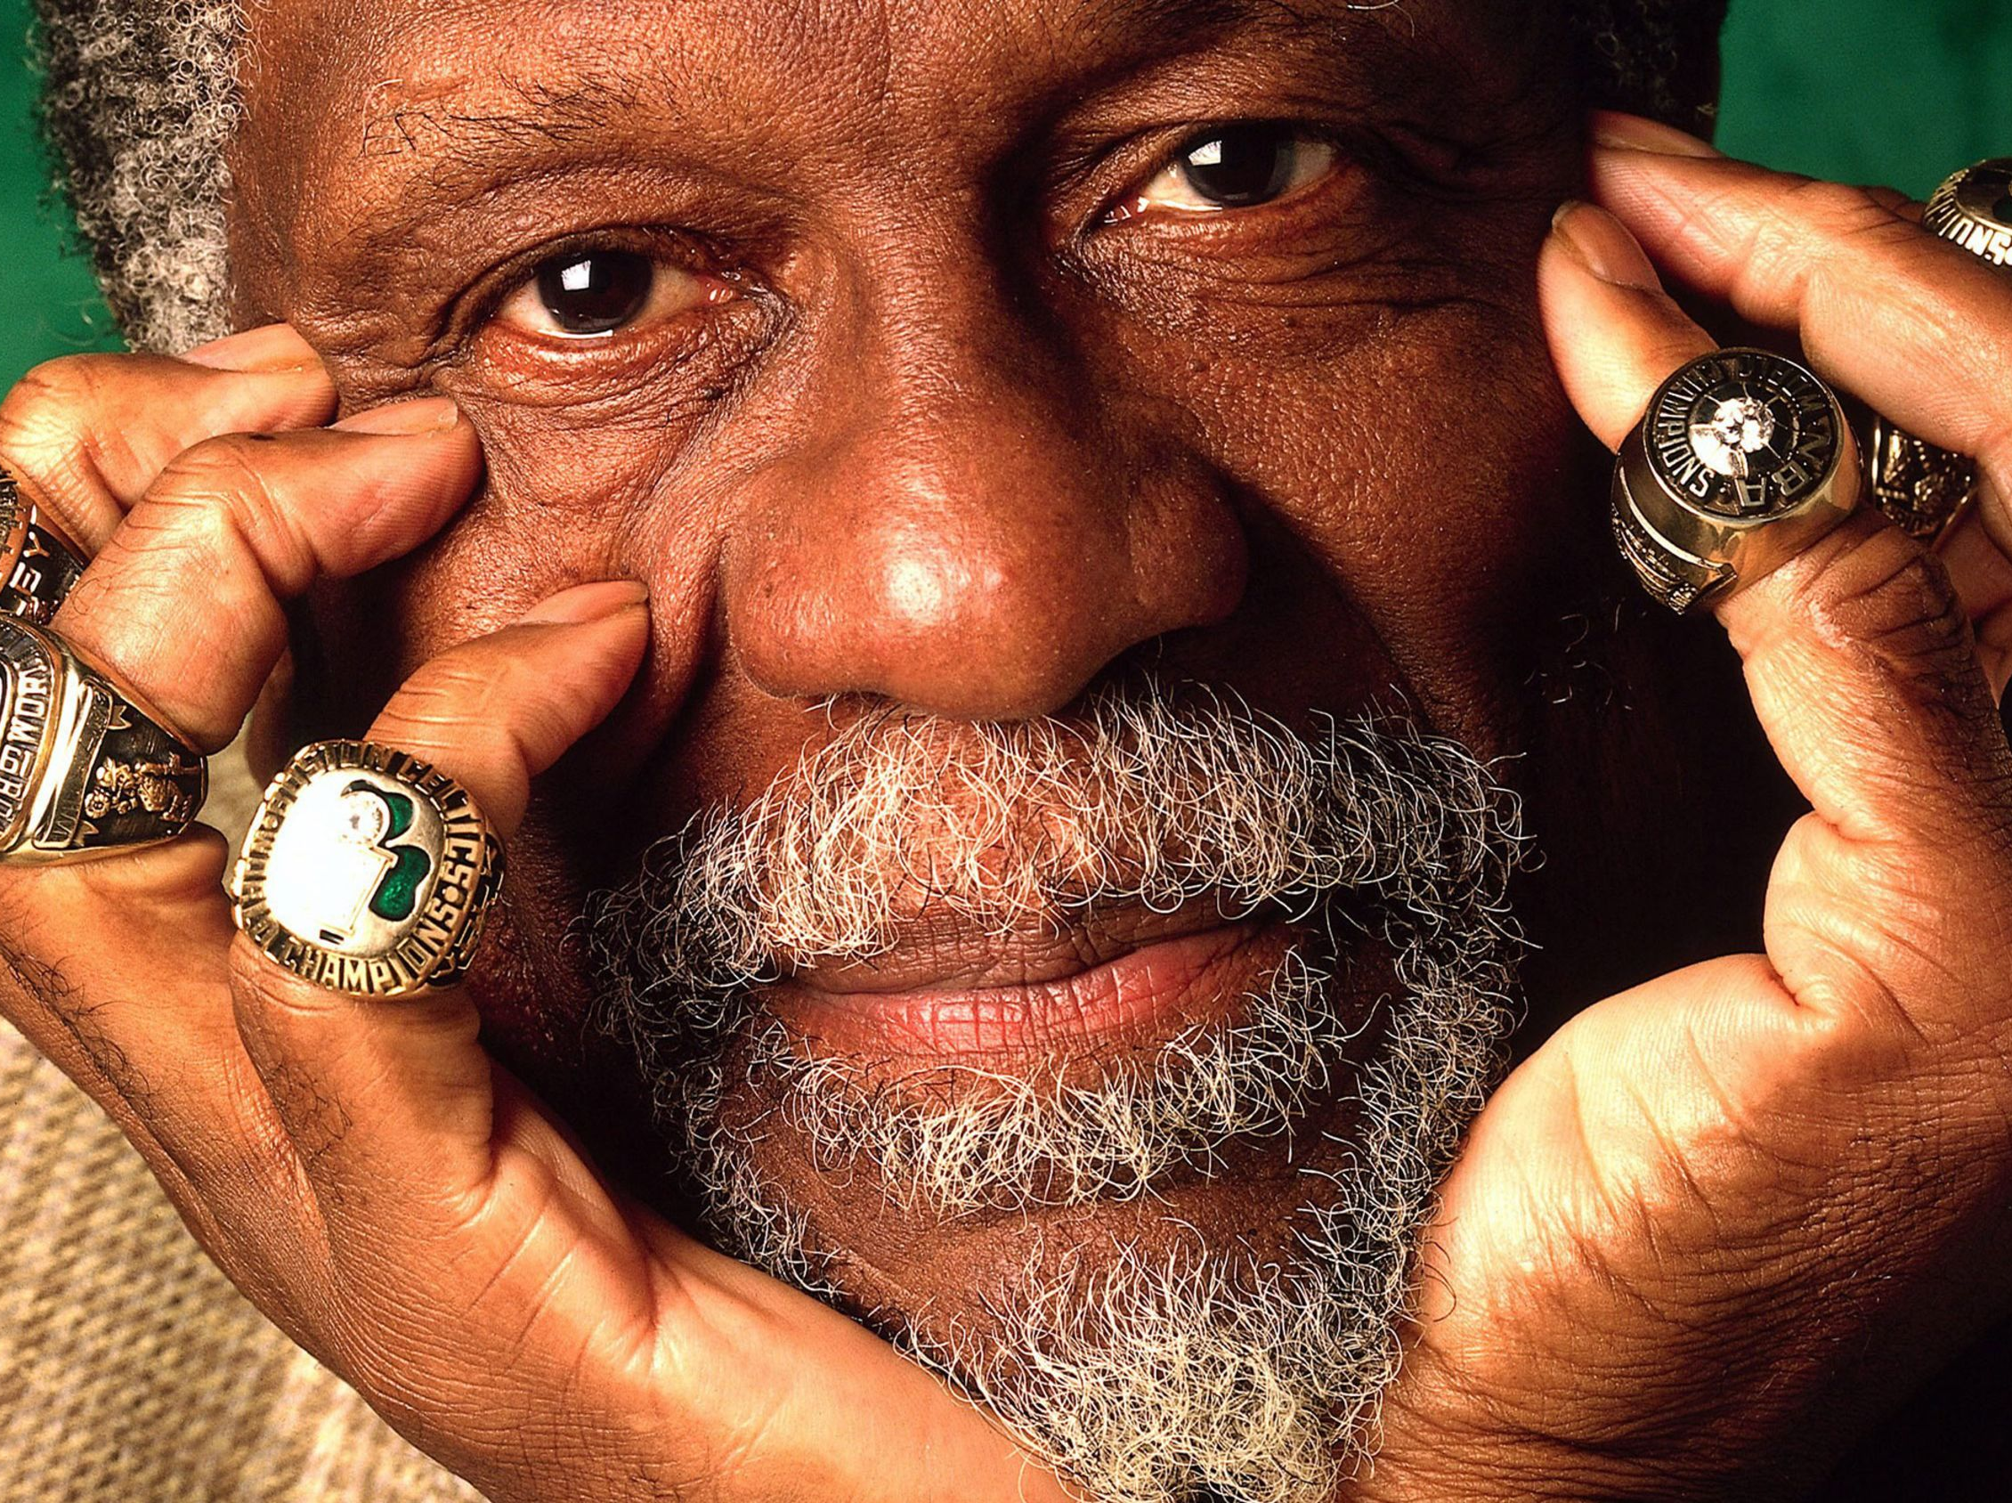
Works cited
Estimating NBA Team Shot Selection Efficiency from Aggregations of True Continuous Shot Charts: A Generalized Additive Model Approach. Sloan Sports Analytics Conference. Retrieved from https://www.sloansportsconference.com/research-papers/estimating-nba-team-shot-selection-efficiency-from-aggregations-of-true-continuous-shot-charts-a-generalized-additive-model-approach
Cervone, D., D'Amour, A., Bornn, L., & Goldsberry, K. (2016). A Multiresolution Stochastic Process Model for Predicting Basketball Possession Outcomes. Retrieved from http://www.lukebornn.com/papers/cervone_ssac_2016.pdf
Offensive Crashing: Using Data to Understand and Optimize Offensive Rebounding. Squared2020. Retrieved from https://squared2020.com/2019/11/18/offensive-crashing/
Extending Possessions: A Geometric Distribution Approach to Basketball Possessions. Squared2020. Retrieved from https://squared2020.com/2019/11/27/extending-possessions-geometric-distribution/

Slide 19

Questions?
Thank you

